Slide 1
Singular Value Decomposition
Vincent Guillemot

Slide 2
Some mental images

Slide 3
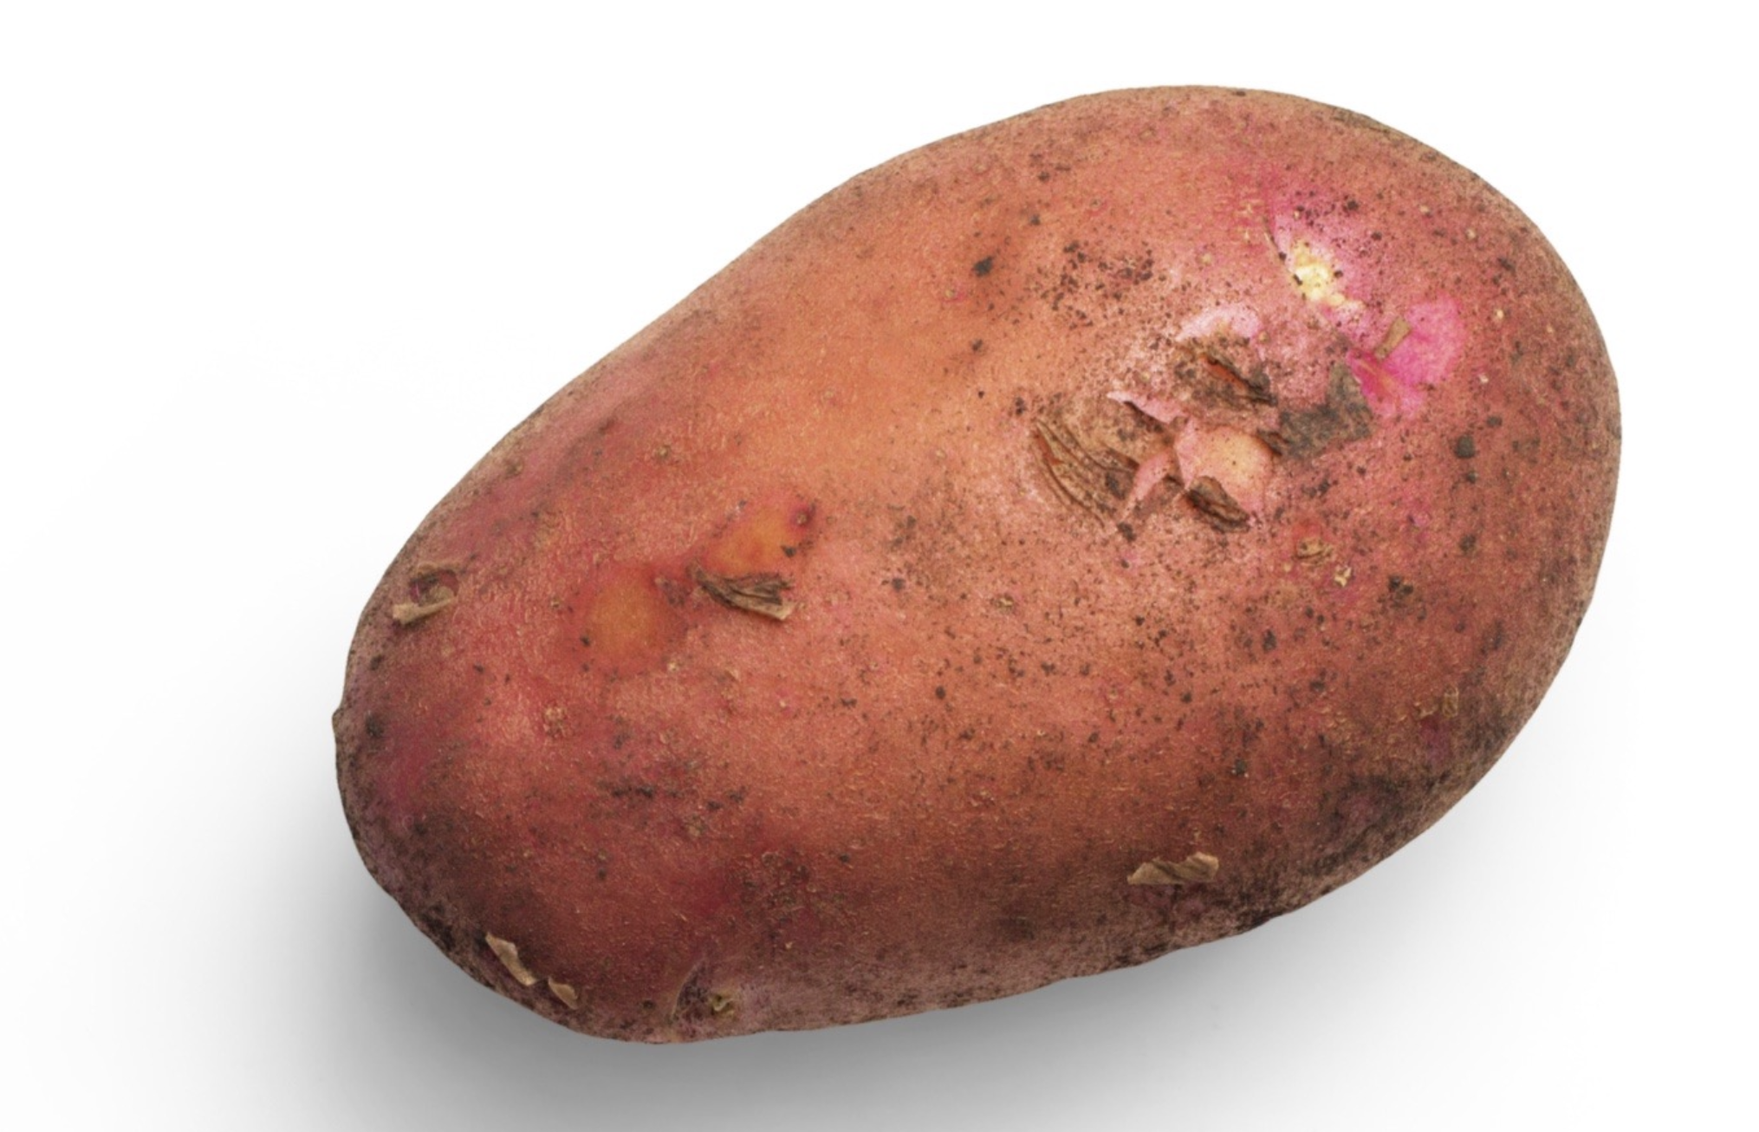
Potato Chips Analysis
Cut the yummiest French fries

Slide 4
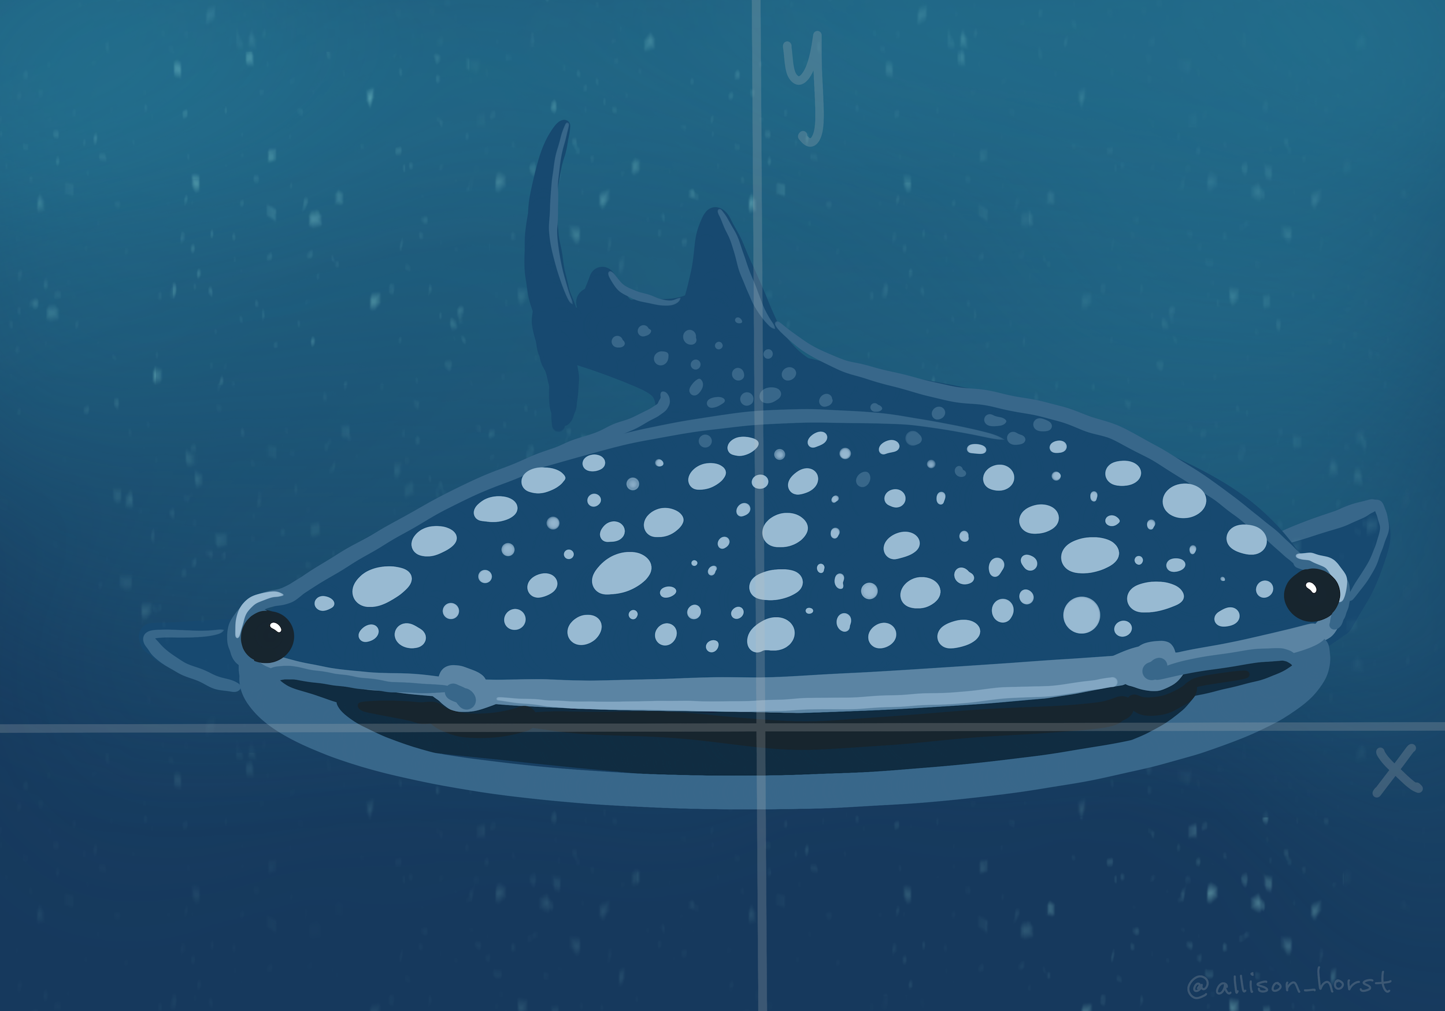
Whale versus krill: this is you (credit: Allison Horst)
Eat the most krill (put on your 3D glasses)

Slide 5
Artwork by @allison_horst

Slide 6
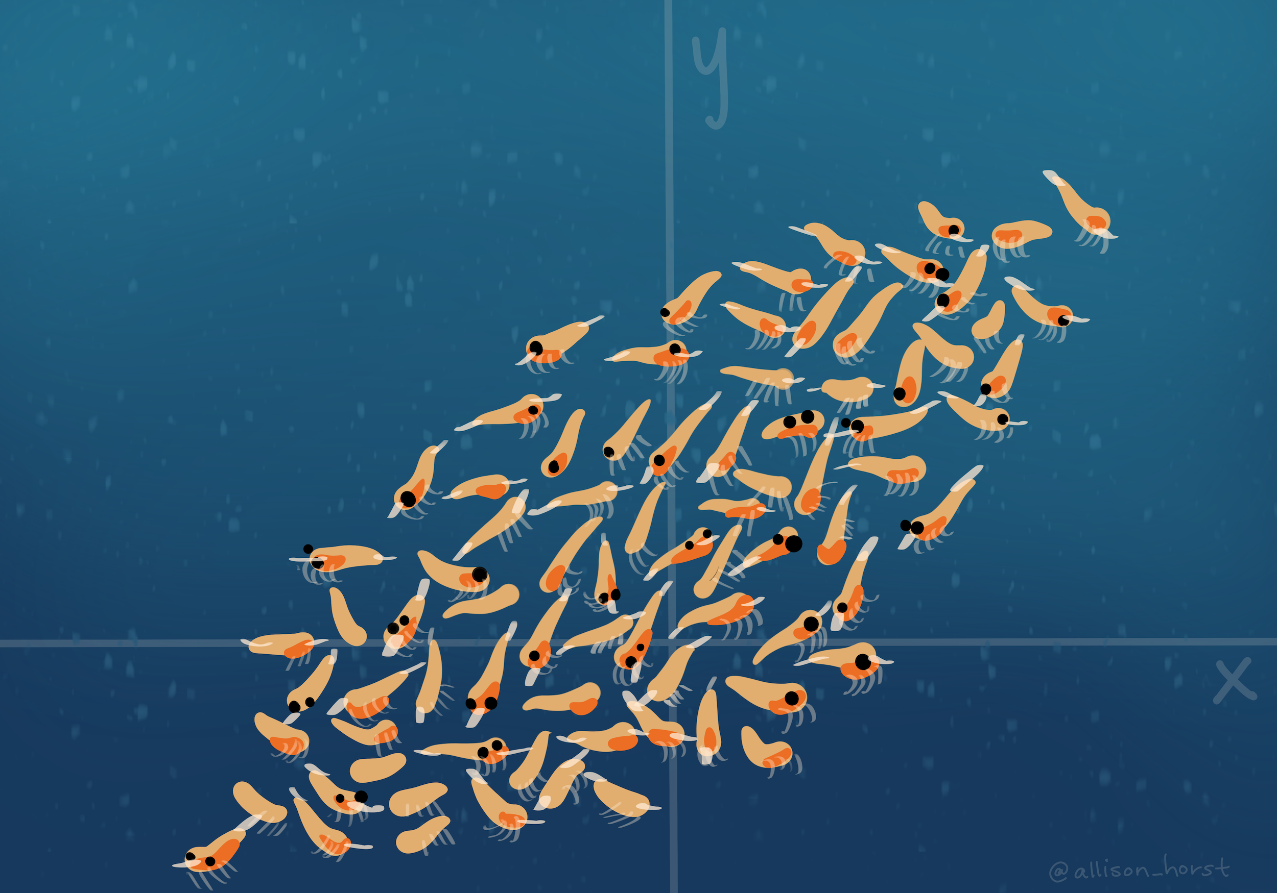
Whale versus krill: this is your data (credit: Allison Horst)
Eat the most krill (put on your 3D glasses)

Slide 7
Artwork by @allison_horst

Slide 8
The tri-force of PCA

Slide 9
Beautiful illustration
Screeplot, versus individual map, versus circle of correlation. With the associated theoretical concepts: inertia (multivariate variance), distance between individuals, and angles between

Slide 10
Example data
xtmp <- readxl::read_excel("../data/simul.xlsx") x <- as.matrix(xtmp[, -1]) rownames(x) <- xtmp$Ind

Slide 11
Example screeplot

Slide 12
Example individual map

Slide 13
Example circle of correlation

Slide 14
Vocabulary

Slide 15
French versus English
English | French
PCA = principal component analysis | ACP = analyse en composantes principales
SVD = singular value decomposition | SVD = décomposition en valeurs singulières
EVD = eigenvalue decomposition | décomposition en éléments propres
ICA = independent component analysis | ICA = analyse en composantes indépendantes
MDS = multidimensional scaling | MDS = multidimensional scaling
“Aaaaah, mais ACP en fait c’est la PCA !”
(Anonymous student, after 6 hours of teaching PCA in French)

Slide 16
R vocabulary
Base methods:
eigen for eigenvalue decomposition, svd for singular value decomposition,
prcomp and princomp for PCA,
biplot
Nice packages:
FactoMineR: PCA, MFA, CA, MCA and associates. In earlier versions, the graphs were “crude”…
factoextra: “helper” package to make beautiful plots, and much more!
ade4: more than “one block” type of analyses. Made by ecologists so $⇒$ PCOA, coinertia analysis, STATIS, etc.
ExPosition: made for psychometricians (they like PLS)

Slide 17
And a few nice books and papers
books and papers

Slide 18
A little bit of Math

Slide 19
Notations
(non-universal) Conventions: matrices and vectors are bold
$I$ = number of observations, $J$ = number of variables (only quantitative)
$i$ for an individual observation, and $j$ for a single variable
$X$ = data matrix, with $n$ rows and $p$ columns, sometimes already centered, and scaled, to make our life easy
$X_{j}$ = variable $j$, and $j$th column of $X$
$w$ a set of weights

Slide 20
A little detour: matrix multiplication
Take a pen and paper, and do this multiplication:
$$\left[\begin{matrix}1 & −1 \\ 0 & 1 \\ 2 & 1\end{matrix}\right]×\left[\begin{matrix}1 & 2 & 3 & 4 \\ −1 & 0 & 0 & 1\end{matrix}\right]$$
Cool video: 5 ways to see matrix multiplication

Slide 21
PCA
“Find a linear combination of the columns of the data that would capture the most information.”
In mathematical words, find
$$Xw=w_{1}X_{1}+⋯+w_{p}X_{p}$$
that maximizes… wait a minute! What are the dimensions?
$X$: $I$ rows and $J$ columns,
$w$: $J$ rows and $1$ columns,
$Xw$: $I$ rows and $1$ column.

Slide 22
The mathematical translation of the intuitions behind PCA

Slide 23
Most popular intuition of PCA: how does it translate?
“PCA creates a linear combination of variables that maximizes variance.”
$$arg\max_{∥w∥_{2}^{2}=1}\text{var}\left(Xw\right)$$
Why $∥w∥_{2}=1$?
Dirty trick: $\text{var}\left(Xw\right)=w^{⊤}X^{⊤}Xw$

Slide 24
Least “well-known” intuition of PCA: how does it translate?
“PCA creates a linear combination of variables that maximizes correlation.”
$$arg\max_{w}\sum_{j=1}^{p}{\text{cor}}{\left(Xw,X_{j}\right)}^{2}$$

Slide 25
Second least “well-known” intuition of PCA: how does it translate?
“PCA creates the best lower rank approximation of the covariance matrix.”
$$arg\min_{∥w∥_{2}^{2}=1}{∥\frac{1}{n}X^{⊤}X−λww^{⊤}∥}_{F}^{2}$$
$\frac{1}{n}X^{⊤}X$
$λ$: the [blank] of the covariance matrix
$w$: the [blank] of the covariance matrix

Slide 26
A little image

Slide 27
Rank-1 approximations

Slide 28
Increasing rank approximations

Slide 29
We can do the same kind of magic with the data itself
Singular value decomposition can be used to approximate a rectangular matrix with a lower ranked matrix of the same dimension
$$arg\min_{∥u∥_{2}^{2}=∥w∥_{2}^{2}=1}{∥X−δuw^{⊤}∥}_{F}^{2}$$
$δ$: singular value
$u$: left singular vector
$w$: right singular vector

Slide 30
Rank 1 approximation

Slide 31
Rank-1 approximations

Slide 32
Increasing rank approximations

Slide 33
Constraining the SVD

Slide 34
LASSO
LASSO is a (relatively) recent technique originally intended for regression problems:
$$arg\min_{β}{∥y−Xβ∥}_{2}^{2}\text{ such that }∥β∥_{1}≤r$$
or the dual form
$$arg\min_{β}{∥y−Xβ∥}_{2}^{2}+λ∥β∥_{1}$$
the obtained weights are sparse (with zeros)
the non-zeros coefficients correspond to important variables
the result is biased
selecting $λ$ is done through cross-validation

Slide 35
Optimization problem
$$\begin{matrix}\left(δ_{ℓ},p_{ℓ},q_{ℓ}\right)=arg\min_{β}{∥X−δp^{⊤}q∥}_{2}^{2} \\ \text{ such that }\left\{\begin{matrix}p^{⊤}Mp=q^{⊤}Wq=1 \\ p^{⊤}Mp_{ℓ^{′}}=q^{⊤}Wq_{ℓ^{′}}=0,∀ℓ^{′}<ℓ \\ ∥p∥_{1}≤s_{p,ℓ}\text{ and }∥q∥_{1}≤s_{q,ℓ}\end{matrix}\right.\end{matrix}$$

